Slide 1
Net Neutrality
Joe James
Math & Computer Science Tutorials
from Silicon Valley

Slide 2
This site has been blocked by your ISP.

Slide 3
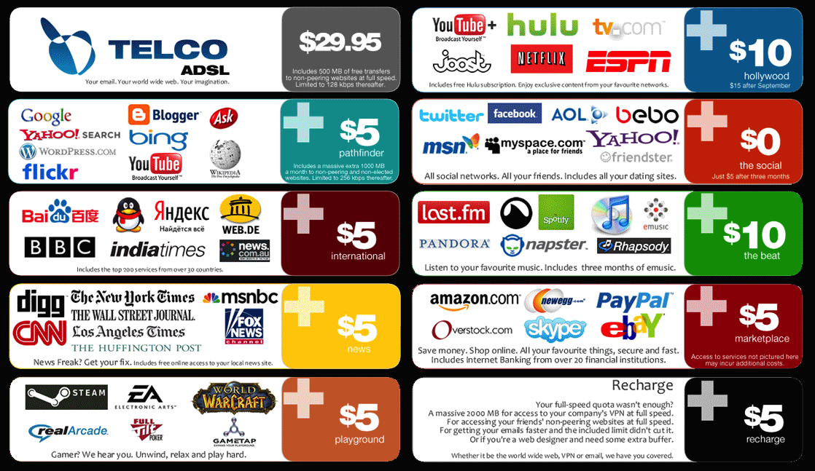

Slide 4
Without Net Neutrality internet service providers could:
Block access to any websites they want.
Throttle (slow down) your bandwidth for certain content types (eg. video streaming).
Charge extra fees for some websites and apps.
Block some device types from accessing some websites.

Slide 5
NET
NEUTRALITY
keep the internet free

Slide 6

© 2017 Joe James

